Slide 1
Deep Learning Computer Architecture
CEG-4136
Instructor: Miodrag Bolic
By: Shuai Niu

Slide 2
Objectives
Applications of deep learning
Have a general idea of what deep learning is
Understand the advantage of deep learning
Know the implementations of deep learning on computer architecture

Slide 3
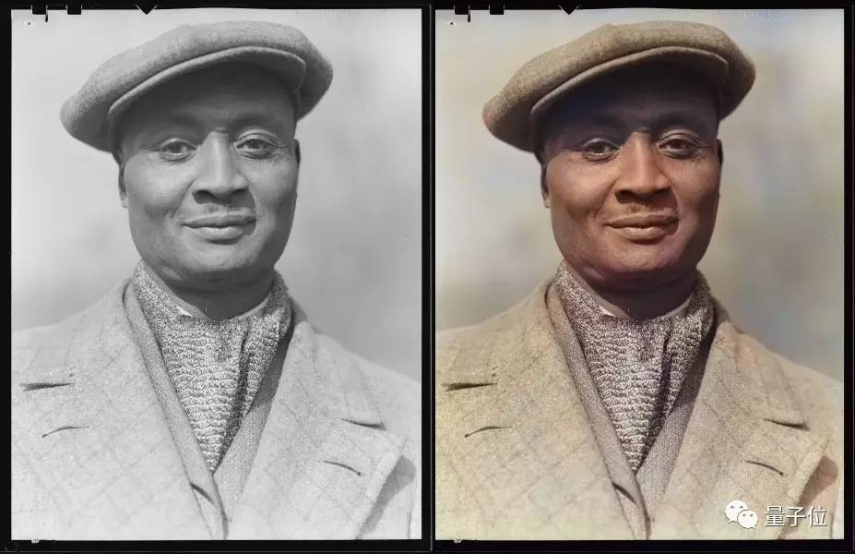
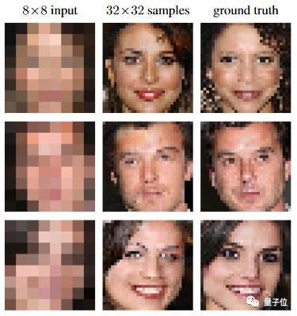
Applications
Auto-coloring
Predicting human face using extremely low resolution
Text analyzing
Text: President Barack Obama completed his tour of Asia, met with leaders, and returned to the US.
Analyze the facts:
Obama is the president of the US.
Obama met with leaders.
Asia has leaders.

Slide 4
Applications
Text Sentiment Analyze
Text: Just got the new iPhone, what a masterpiece!
Analyze: Happy, amazed.
Financial fraud detection, advertising(guess you like…)
Voice recognition, translation..
Many more…

Slide 5
What is deep learning?
A subfield of machine learning concerned with algorithms inspired by the structure and function of the brain called :
“Artificial Neural Networks” or “Deep Neural Networks”
Capable of learning unsupervised data that is unstructured

Slide 6
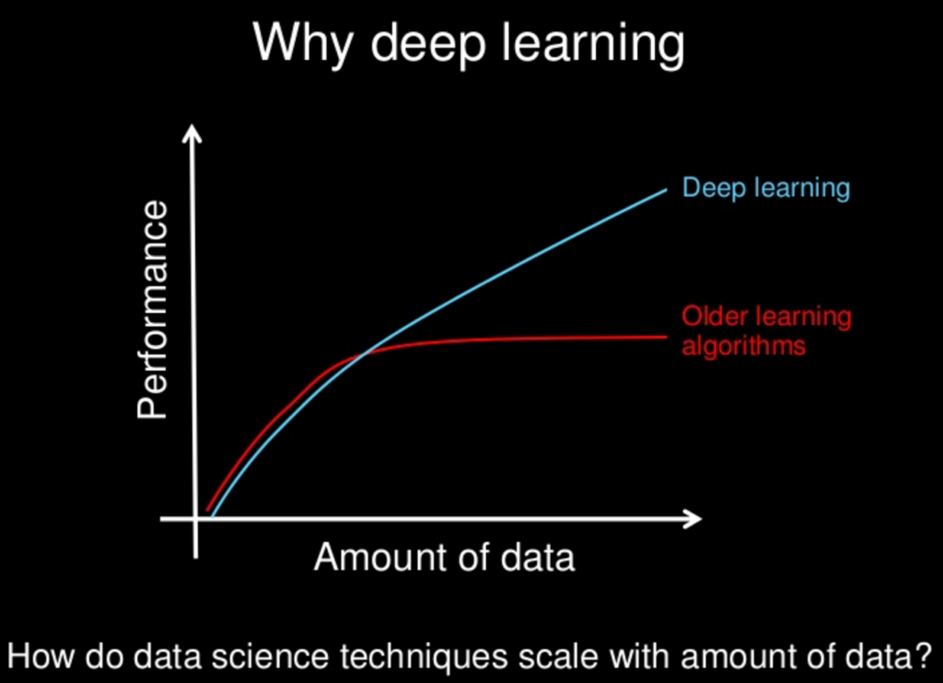
Why deep learning?
Bigger data means better performance
Performance continues to increase as data becomes larger
Other machine learning algorithms cannot have such performance increase

Slide 7
Why deep learning?
Much more accurate than traditional learning models.
An example (In a nutshell):
Traditional way of training a machine to recognize cat and tiger
Give machine sets of features: eyes, furs, claws, sounds…etc
High error rate, as features(tags) become more, machine sometimes cannot correctly tell whether this picture is a cat or a tiger.

Slide 8
Why deep learning?
Deep learning training method
Give machine millions of pictures with cats . Then give another millions of pictures without cats.
Use deep learning and its neural networks to let the machine recognize by itself which ones are cats without telling machine the features.
Q1. Why is this way better?
Think about when prof ask you to memorize a definition then write down the exact sentence(you probably get marks off). Or ask you to understand a definition then rephrase it in your own words(higher chance to get full marks).

Slide 9
Understand Neural Networks
Q2.Neural network is not a new concept, why is deep learning neural network different than others?
A neural network which has many hidden layers
Traditional neural networks consists of input layer, hidden layers and output layer.
Deep neural network expands the hidden layers so that less network parameters are needed.

Slide 10
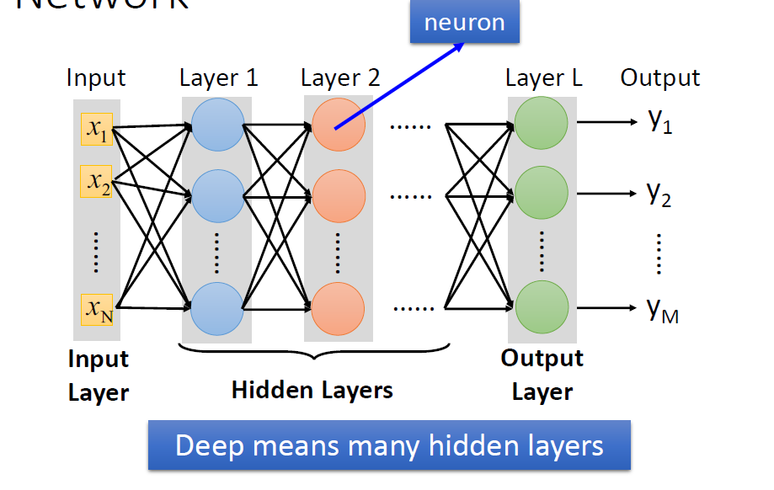
Understand Neural Networks
Layers are interconnected in a complex way

Slide 11
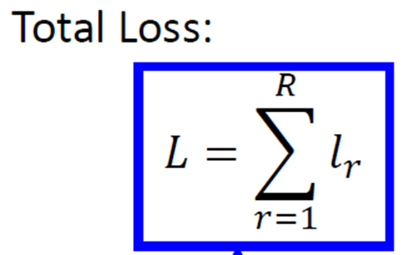
Understand Neural Networks
Q3.Is more hidden layers always good?
Not necessarily, to determine if the function set(network) is good
The least value of L means the best neural
network.
Details are mathematical.

Slide 12
What can we do about deep learning as computer engineers?
Q4.What is the bottleneck of deep learning?
Hardware limits, tooling fragmentation(since different purpose needs different neural networks, and different neural networks needs different platform to train), architecture design
One approach is to build an accelerator (combination of software and hardware) to improve the training speed of deep neural network.
Key concept: Minerva
A three-pronged approach

Slide 13
Introduction to Minerva
Three levels design: Software, hardware and circuits.
Minerva addresses this issue (fragmentation) with a layered design that provides language flexibility and execution efficiency simultaneously within one coherent framework.
It can run on laptop, workstation, multi-core server, and even server clusters. Same user codes all the way through.

Slide 14
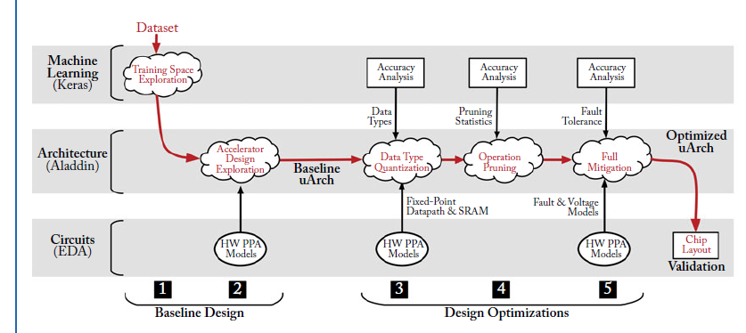
Five-stage design

Slide 15
Software Level: Keras
A software model built on top of the Keras machine learning library
GPU-accelerated code enables us to explore the large hyperparameter space during stage 1. (Parameters assigned with values prior to learning process)
There are analytical codes built around Keras to test neural network accuracy.
Notes:
To prune insignificant activations (Stage 4), a
thresholding operation is added to the activation function of each neural network layer. This
function checks each activity value and zeros all activations below the threshold, removing them
from the prediction computation. To study faults in neural network weights (Stage 5), we built a
fault injection framework around Keras. Before making predictions, the framework uses a fault
distribution, derived from SPICE simulations for low-voltage SRAMs, to randomly mutate
model weights. If a user wishes to add an unsafe optimization, it needs to be implemented in
the software model.

Slide 16
Architecture Level: Aladdin
A cycle-accurate, power, performance, and area simulator(PPA)
Automates a large design space exploration of microarchitectural parameters found in stage1 (loop level parallelism, memory bandwidth, clock frequency, etc.)
Extended to support fixed-point data types, operation pruning and SRAM fault detection
Each variable and array in C is tagged to specify its precision.
Nominal SRAM libraries are replaced with low-voltage libraries for power modeling.

Slide 17
Circuit Level: EDA
Aladdin requires detailed PPA hardware characterization to be fed into its models to get accurate results.
These characterization libraries are built using PrimePower for all datapath elements needed to simulate neural network accelerators with commercial standard cell libraries in 40 nm CMOS.
Q5.Is Aladdin aware of network accuracy?
Note that Aladdin only models the PPA of the workload, and error at architecture level. (Between simulation and real hardware)

Slide 18
Conclusion
Deep learning is still a fast-growing new area to explore.
Computer engineers still have a lot of works to do to optimize deep learning algorithm and its hardware performance.
Programming the training algorithms in parallel and making them compatible with many cores system can greatly increase the training efficiency.

Slide 19
Questions?

Slide 20
References
https://stanford.edu/~rezab/nips2014workshop/submits/minerva.pdf
https://machinelearningmastery.com/supervised-and-unsupervised-machine-learning-algorithms/
http://www.cs.toronto.edu/~hinton/science.pdf
http://machinelearning.wustl.edu/mlpapers/paper_files/AISTATS2010_ErhanCBV10.pdf
https://www.slideshare.net/ExtractConf
https://machinelearningmastery.com/what-is-deep-learning/
http://tech.ifeng.com/a/20171003/44706297_0.shtml (Chinese site)

Slide 21
Thank you!

